Slide 1

Data Science for Policy Independent analysis Data Science Campus Graduate Programme September 2023
Notes:
Hi,
I hope that you are all doing well this morning, my name is Jac Williams. As a data scientists in the spatial data unit in the department of levelling up, our role involves exploring the spatial differences across the UK using data to provide insights and recommendations.

Slide 2

Has the increasing price of energy affect commuters’ transport habits?
Main Points
The CPI rate for transport services has consistently been higher than the overall index over the last 14 years.
Throughout 2022 and 2023, both the overall rate and the transport services rate of inflation has been consistently higher than previous years.
Gas prices rose considerably in 2021 and has maintained the high rates. Although there are early signs of prices returning to previous rates.
There is a big difference in the rates that individuals walk as their mode of transport when they are not commuting compared to when they are.
There are spatial disparities between the rate of commuters who travel to work by car compared to alternative methods.
Those who mainly work from home tend to be earning a higher income and live in the south of England / outskirts of London. Meaning they will feel the effects of the rising price of energy differently to others.
Data Science for Policy – September 2023
2
2
Notes:
In particular, we centre our analysis around the 12 levelling up missions, of which, one of the missions is education, which has stated metrics such as the number of primary school children achieving the expected standard in reading, writing and maths. Today, we are interested in if there are spatial disparities in school absences across both England and Wales and how this links to the other levelling up metrics. The governance of education has been devolved in Wales since the creation of the Welsh assembly in 1999 and therefore the collection of school absence data is done independently between England and Wales. The differences in the data collection methods amount to things such as counting half day sessions missed instead of the percentage of pupils absent, how required attendance is counted, etc.

Slide 3
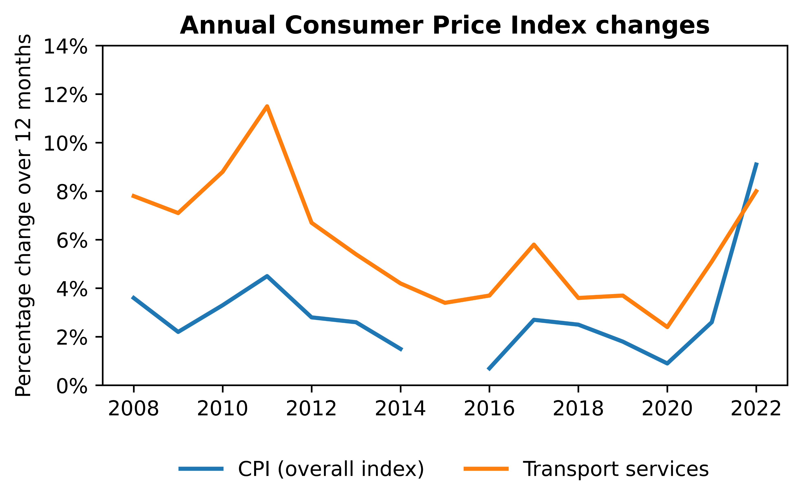
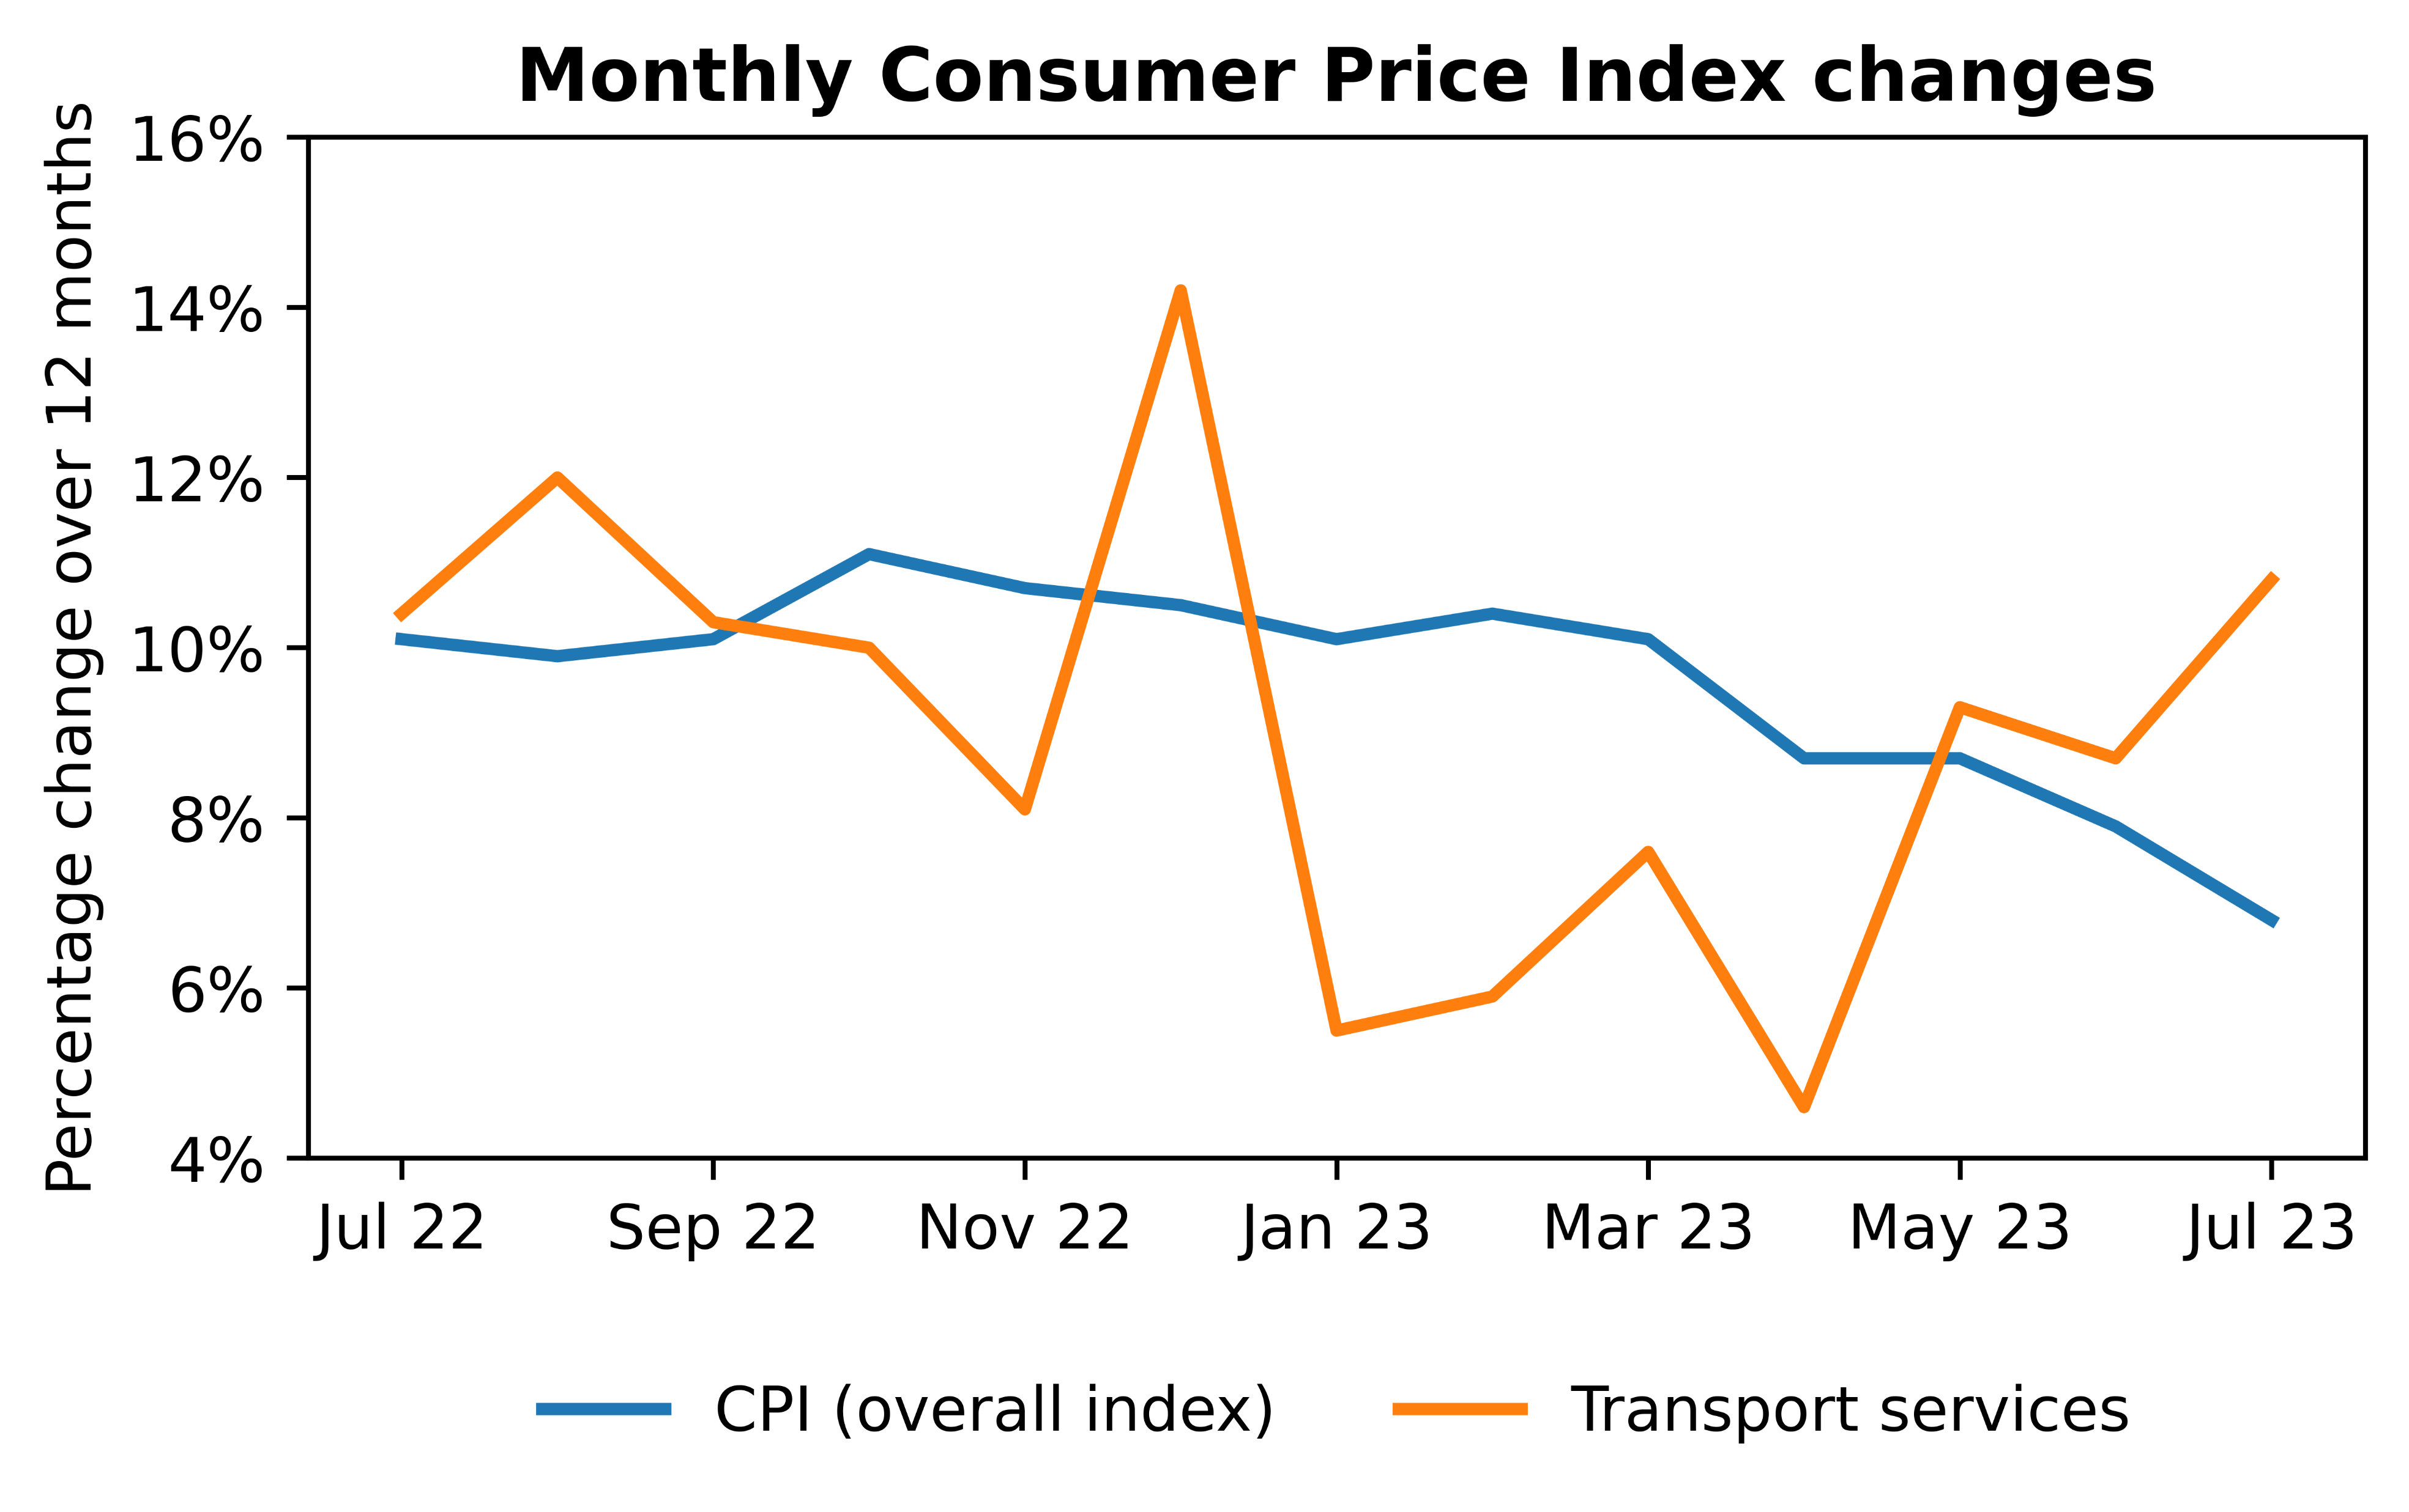
Has the increasing price of energy affect commuters’ transport habits?
CPI trends
The Consumer price index (CPI) has shown clear volatility over the last 14 years with it mostly remaining below 5% from 2008 to 2021. Then, in 2022, we’ve seen a sharp increase in the rate of inflation, reaching 40-year highs. Furthermore, observing the monthly cpi figure, we notice that the high levels of inflation has continued throughout 2022 & 2023, although it is showing signs of slowing down.
Conversely, we see that the inflation rate of transportation has consistently been higher than the overall rate of inflation, showing high rates particularly in 2011 (11.5%) before closing the gap over the following years. Similar to the overall inflation rate, we can see that the inflation rate for transport services increase in 2022 and maintains it’s high level throughout 2022 and 2023. Although, there isn’t as clear of a downward trend compared to the overall index.
Data Science for Policy – September 2023
3
3
Notes:
In particular, we centre our analysis around the 12 levelling up missions, of which, one of the missions is education, which has stated metrics such as the number of primary school children achieving the expected standard in reading, writing and maths. Today, we are interested in if there are spatial disparities in school absences across both England and Wales and how this links to the other levelling up metrics. The governance of education has been devolved in Wales since the creation of the Welsh assembly in 1999 and therefore the collection of school absence data is done independently between England and Wales. The differences in the data collection methods amount to things such as counting half day sessions missed instead of the percentage of pupils absent, how required attendance is counted, etc.

Slide 4
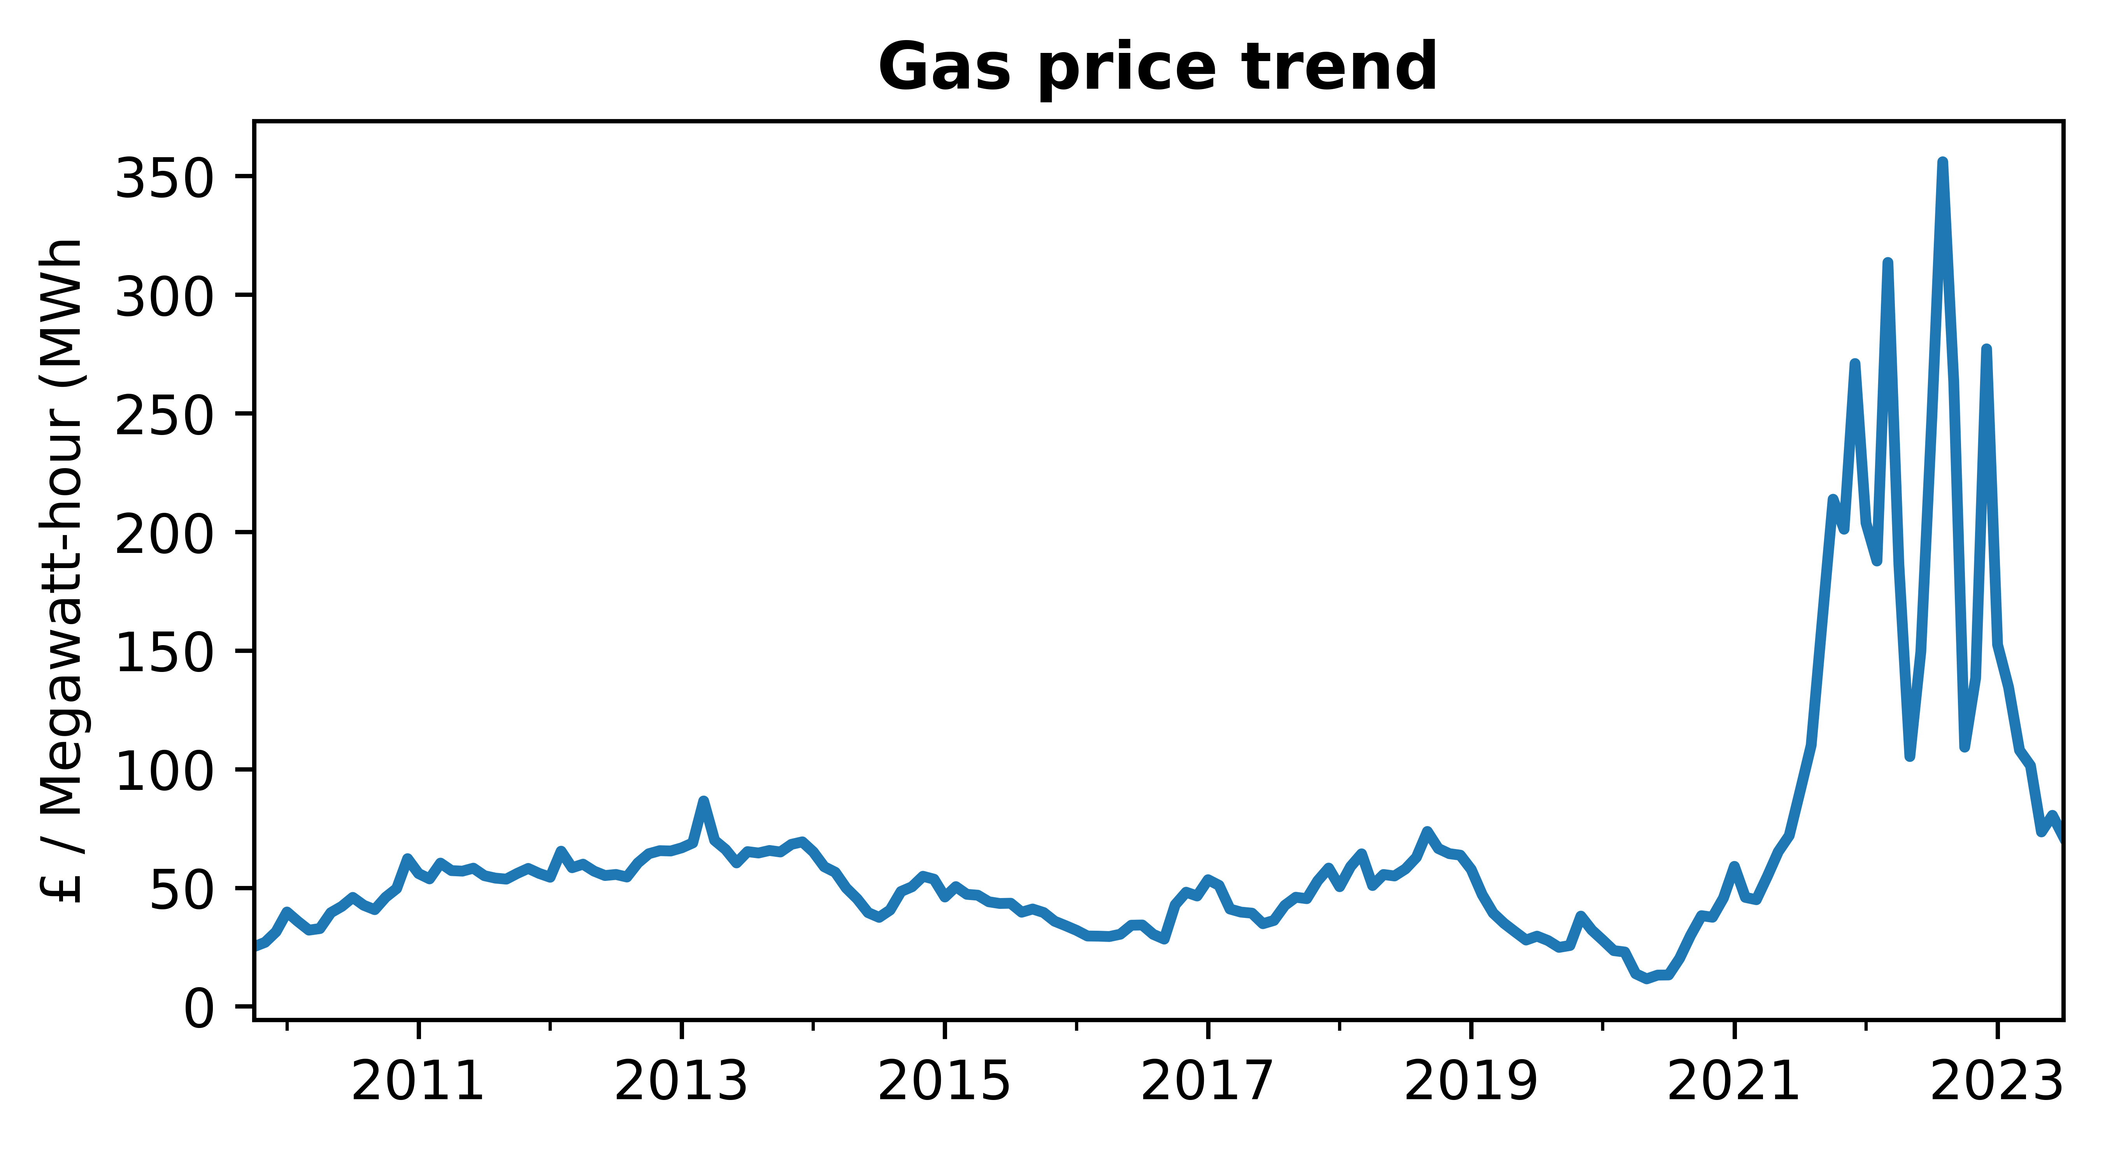
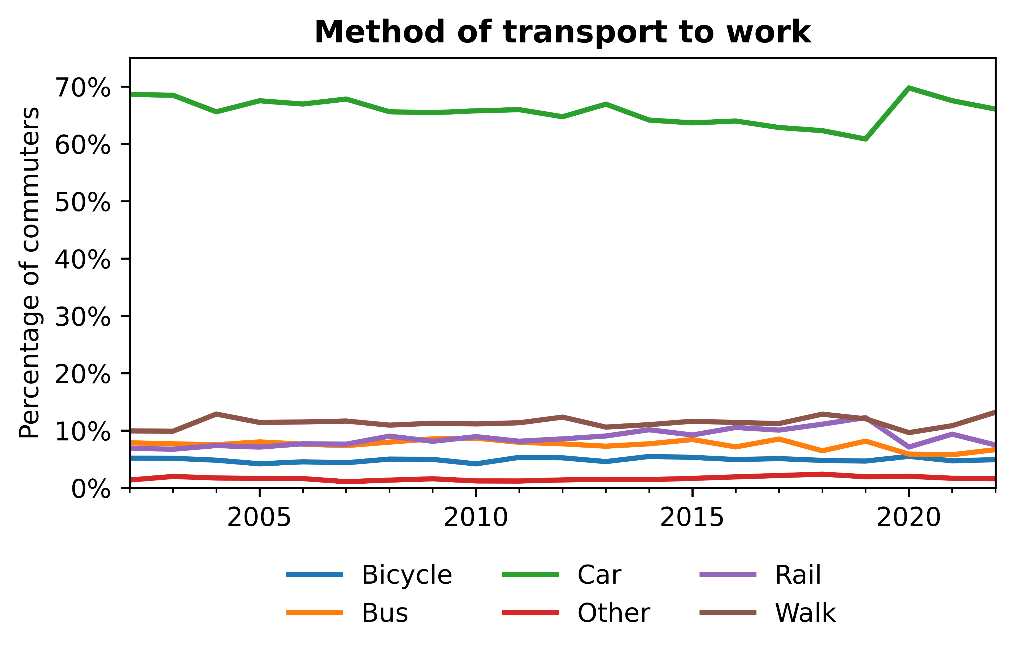
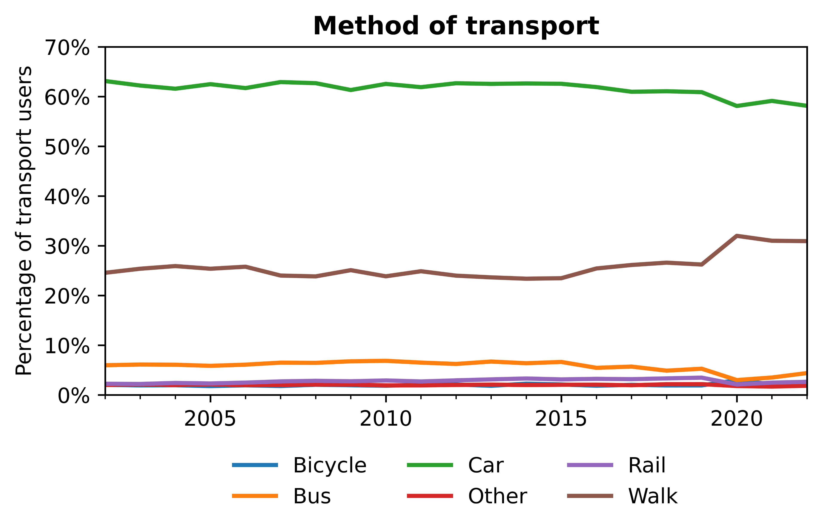
Has the increasing price of energy affect commuters’ transport habits?
Transport trends
We define the energy intensity of CPI as the indirect effects of energy price movements on the rate of inflation. It is estimated that the mean energy intensity of the transport sector stands at 18.7% indicating high exposure to the increase cost of energy (which can be seen in the figure to the right). There is some indication at the moment of gas prices returning to previous rates, however, it is still too early to be certain.
Furthermore, I’ve chosen to explore the potential ramifications on individual’s transport habits. As you can see from the following figures, most commuters travel to work by car as opposed to public transport or walking. Transport by car remains dominant for overall transport, however walking is a lot more favorable when not on the way to work.
Data Science for Policy – September 2023
4
4
Notes:
In particular, we centre our analysis around the 12 levelling up missions, of which, one of the missions is education, which has stated metrics such as the number of primary school children achieving the expected standard in reading, writing and maths. Today, we are interested in if there are spatial disparities in school absences across both England and Wales and how this links to the other levelling up metrics. The governance of education has been devolved in Wales since the creation of the Welsh assembly in 1999 and therefore the collection of school absence data is done independently between England and Wales. The differences in the data collection methods amount to things such as counting half day sessions missed instead of the percentage of pupils absent, how required attendance is counted, etc.

Slide 5
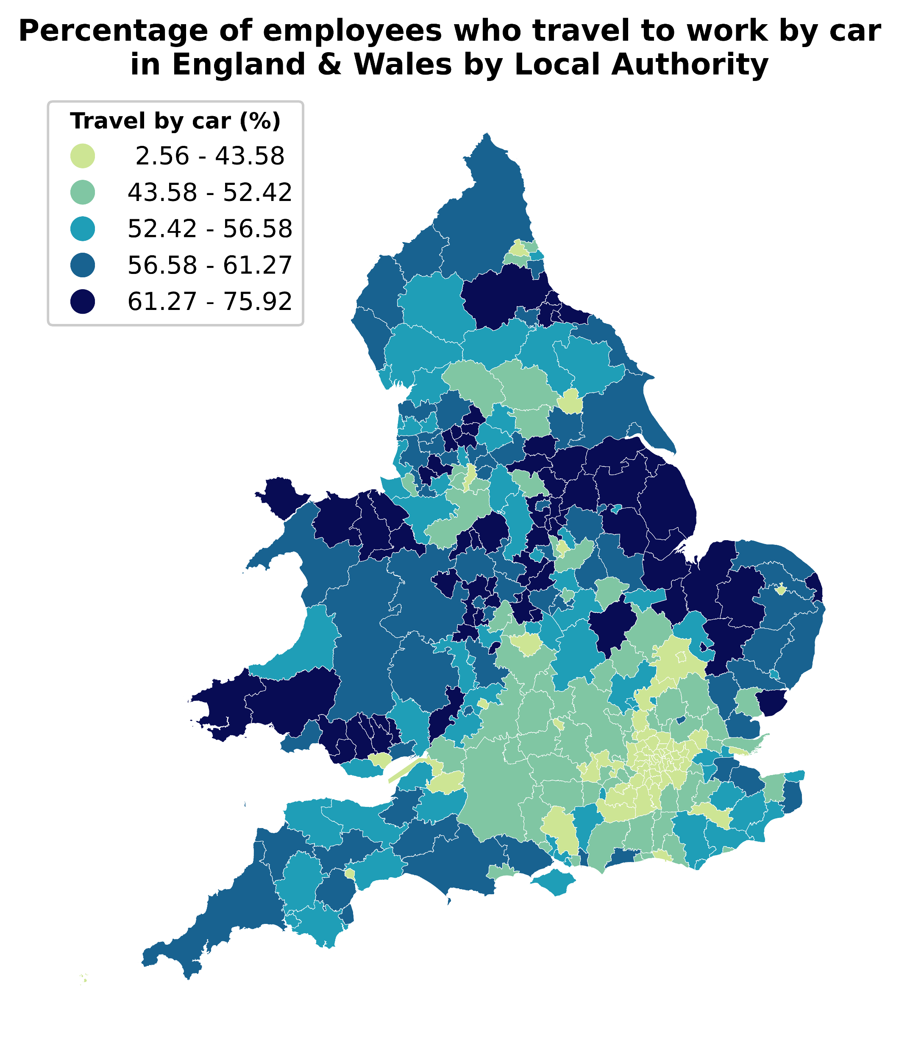
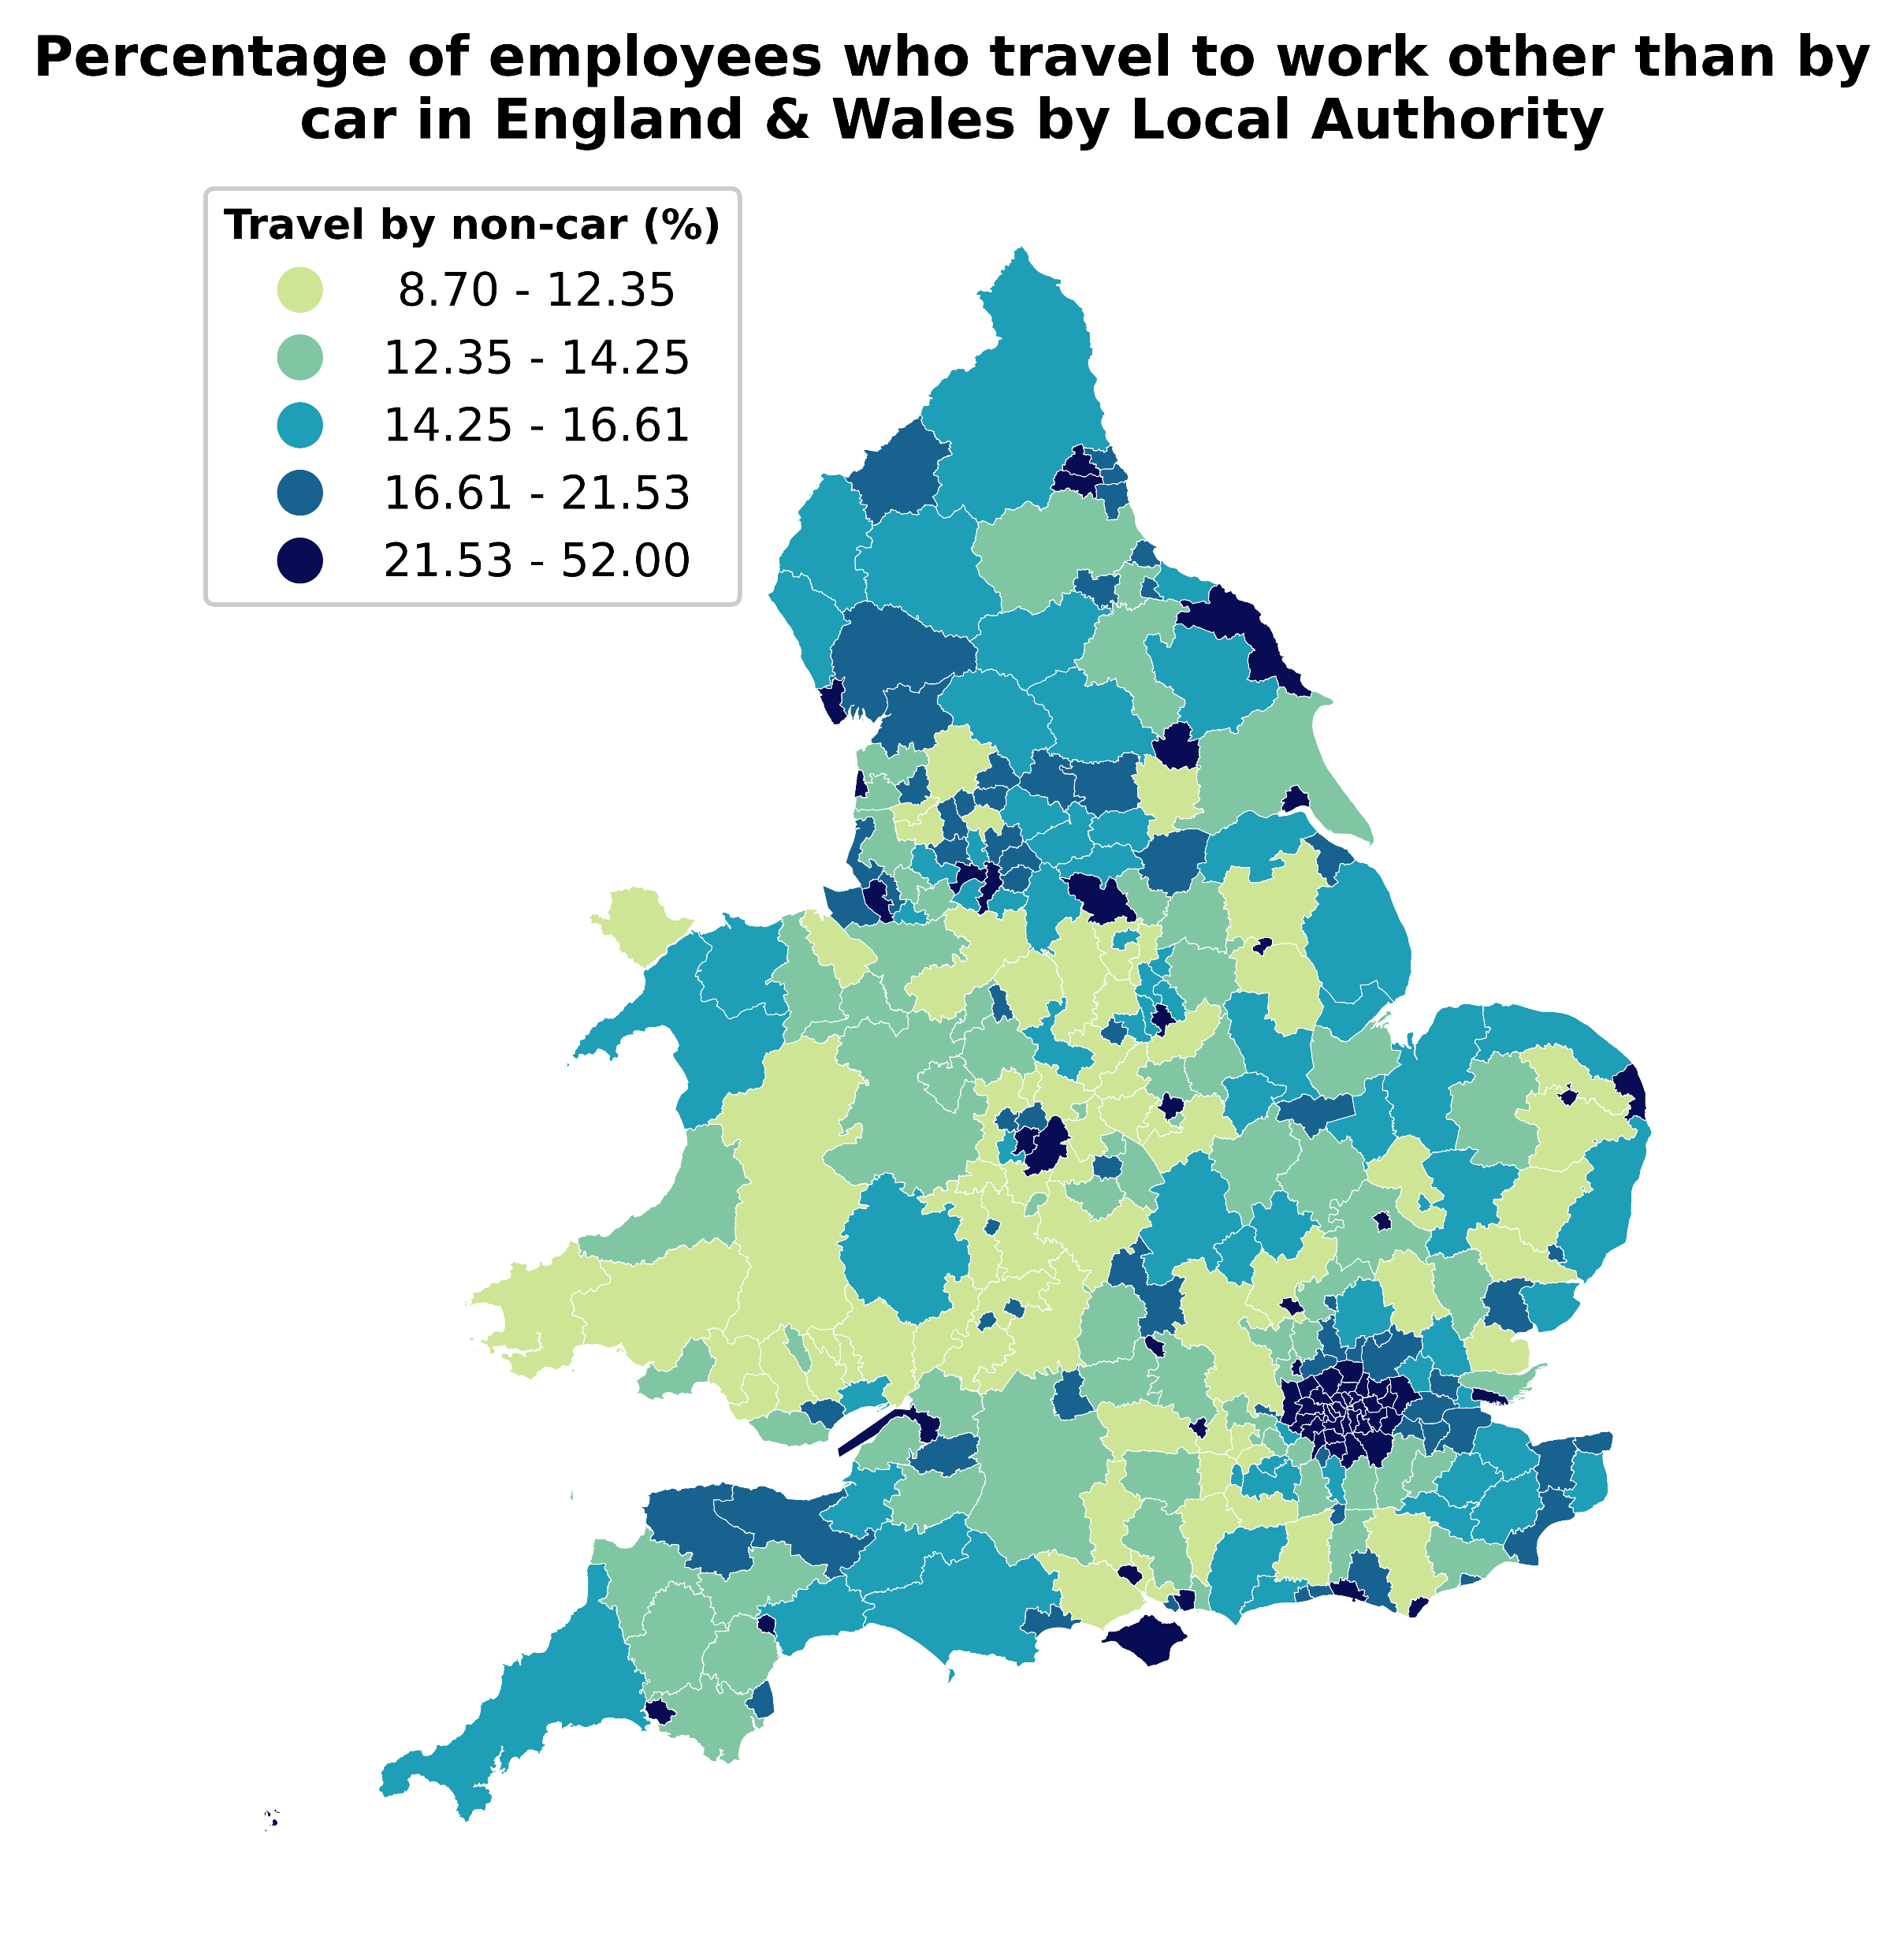
Has the increasing price of energy affect commuters’ transport habits?
Transport trends
Additionally, individuals transport habits require further analysis as there are significantly greater nuances to consider. For example, as seen from the following maps, the areas showing the highest rates of travel to work by methods other than by car is London and other cities such as Oxford, Manchester, Cardiff, etc. Therefore, the main questions arising from these observations are:
Will the increasing cost of energy effect the transport habits of those in cities?
Will individuals living outside of cities be affected more by the rising cost of gas without alternative transport options being readily available?
Data Science for Policy – September 2023
5
5
Notes:
In particular, we centre our analysis around the 12 levelling up missions, of which, one of the missions is education, which has stated metrics such as the number of primary school children achieving the expected standard in reading, writing and maths. Today, we are interested in if there are spatial disparities in school absences across both England and Wales and how this links to the other levelling up metrics. The governance of education has been devolved in Wales since the creation of the Welsh assembly in 1999 and therefore the collection of school absence data is done independently between England and Wales. The differences in the data collection methods amount to things such as counting half day sessions missed instead of the percentage of pupils absent, how required attendance is counted, etc.

Slide 6
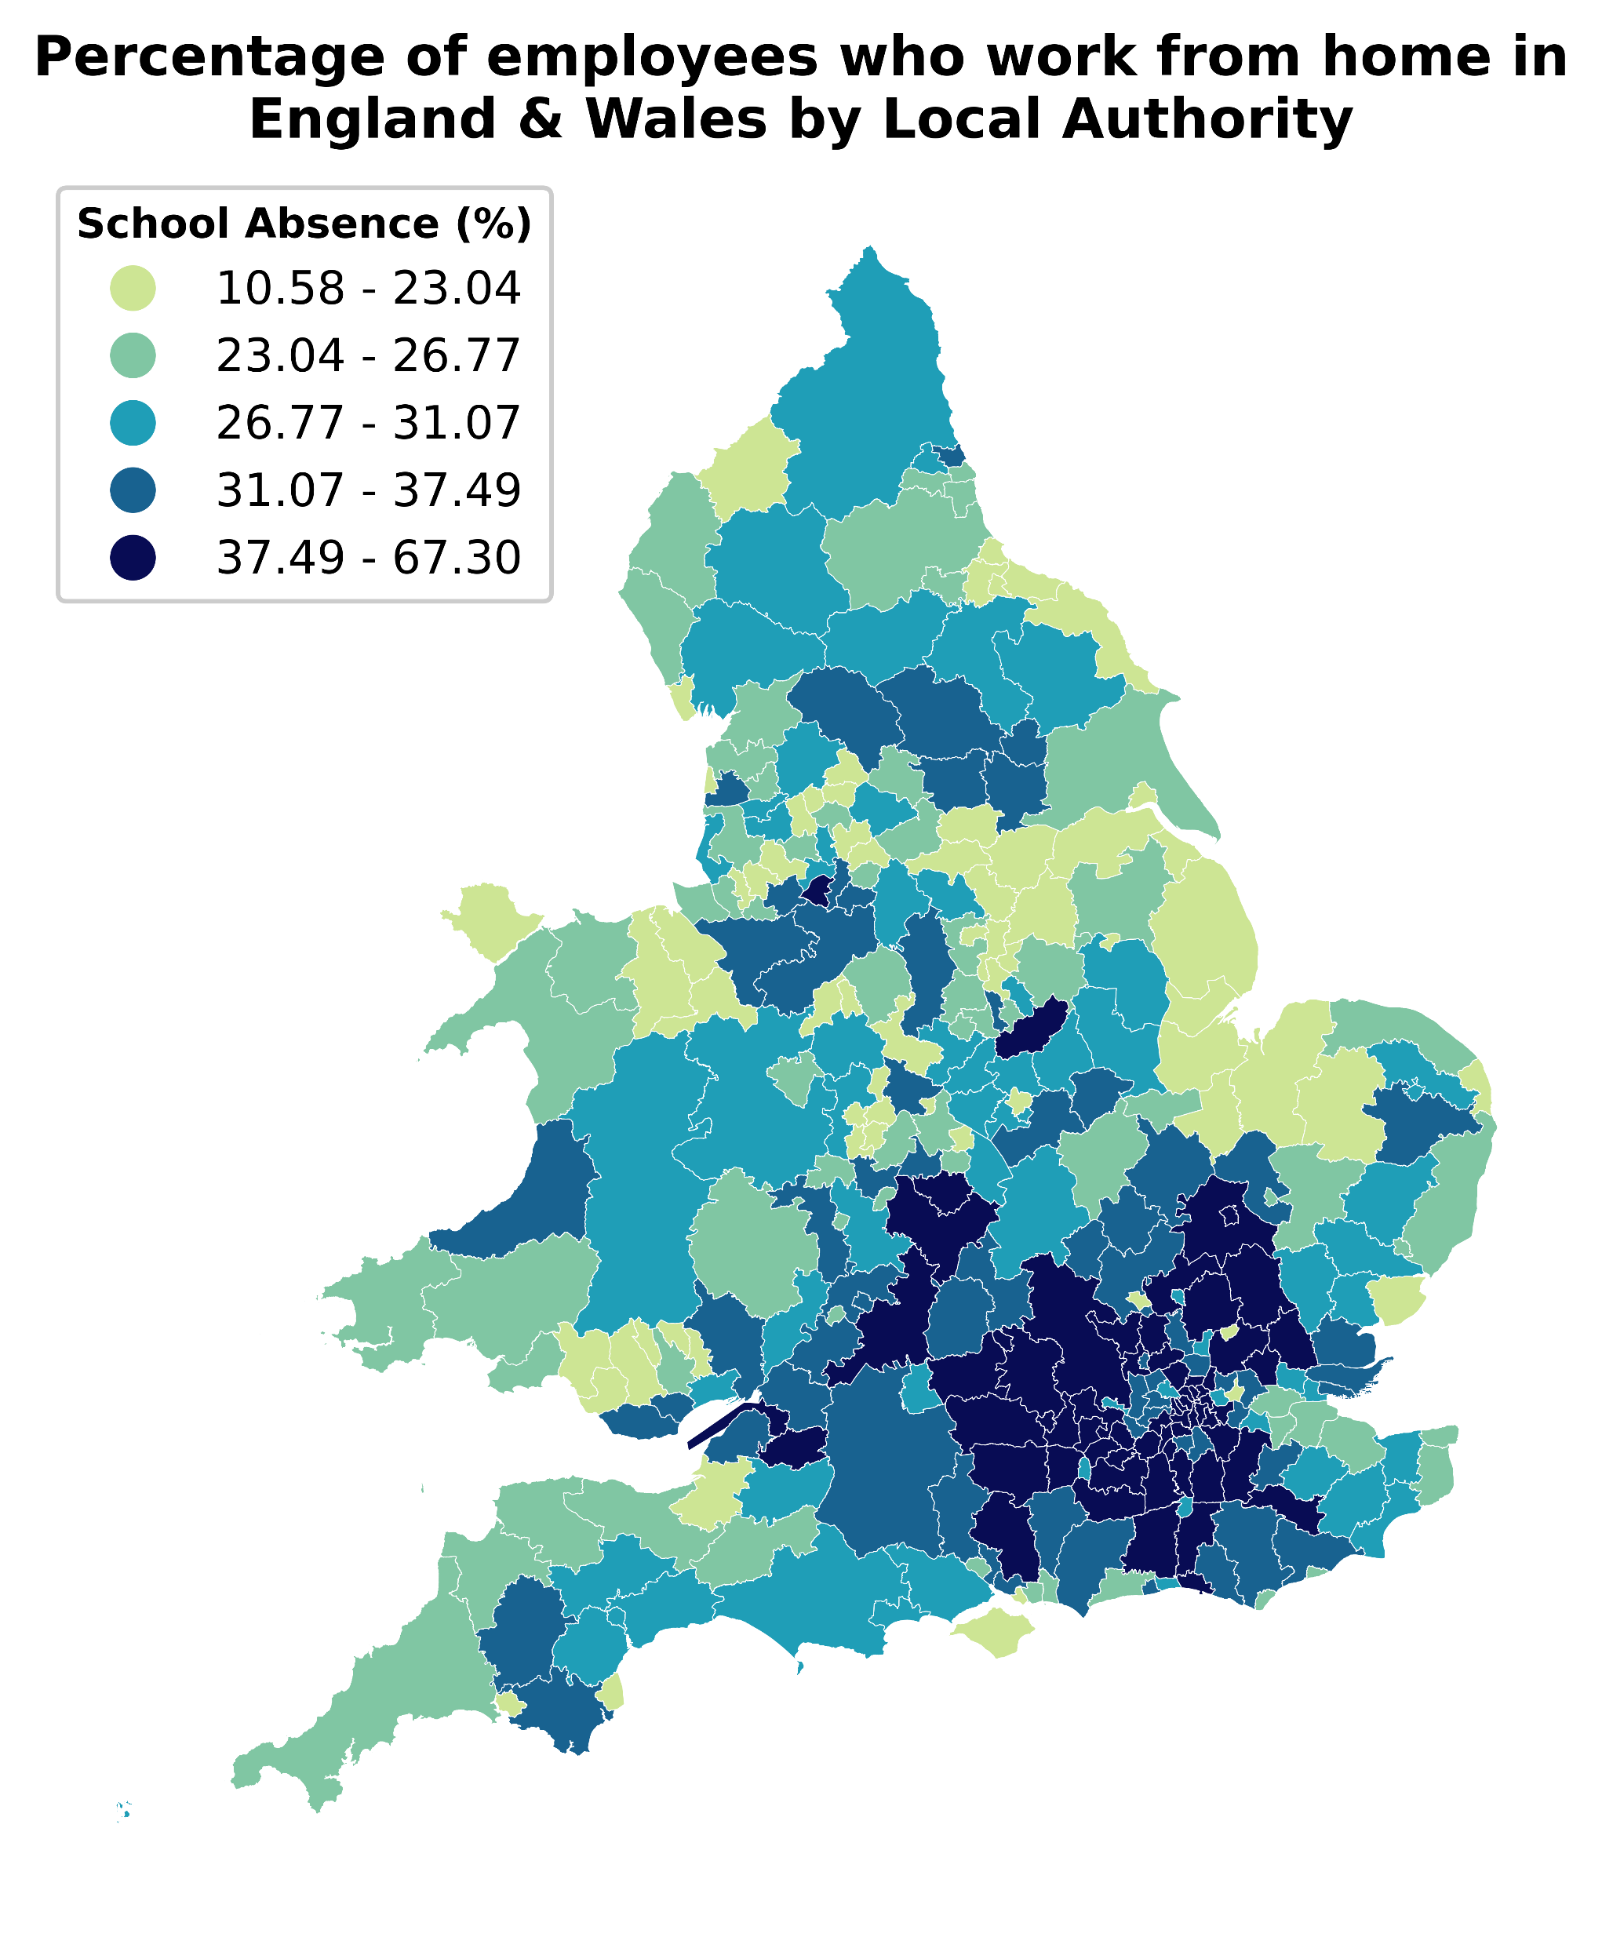
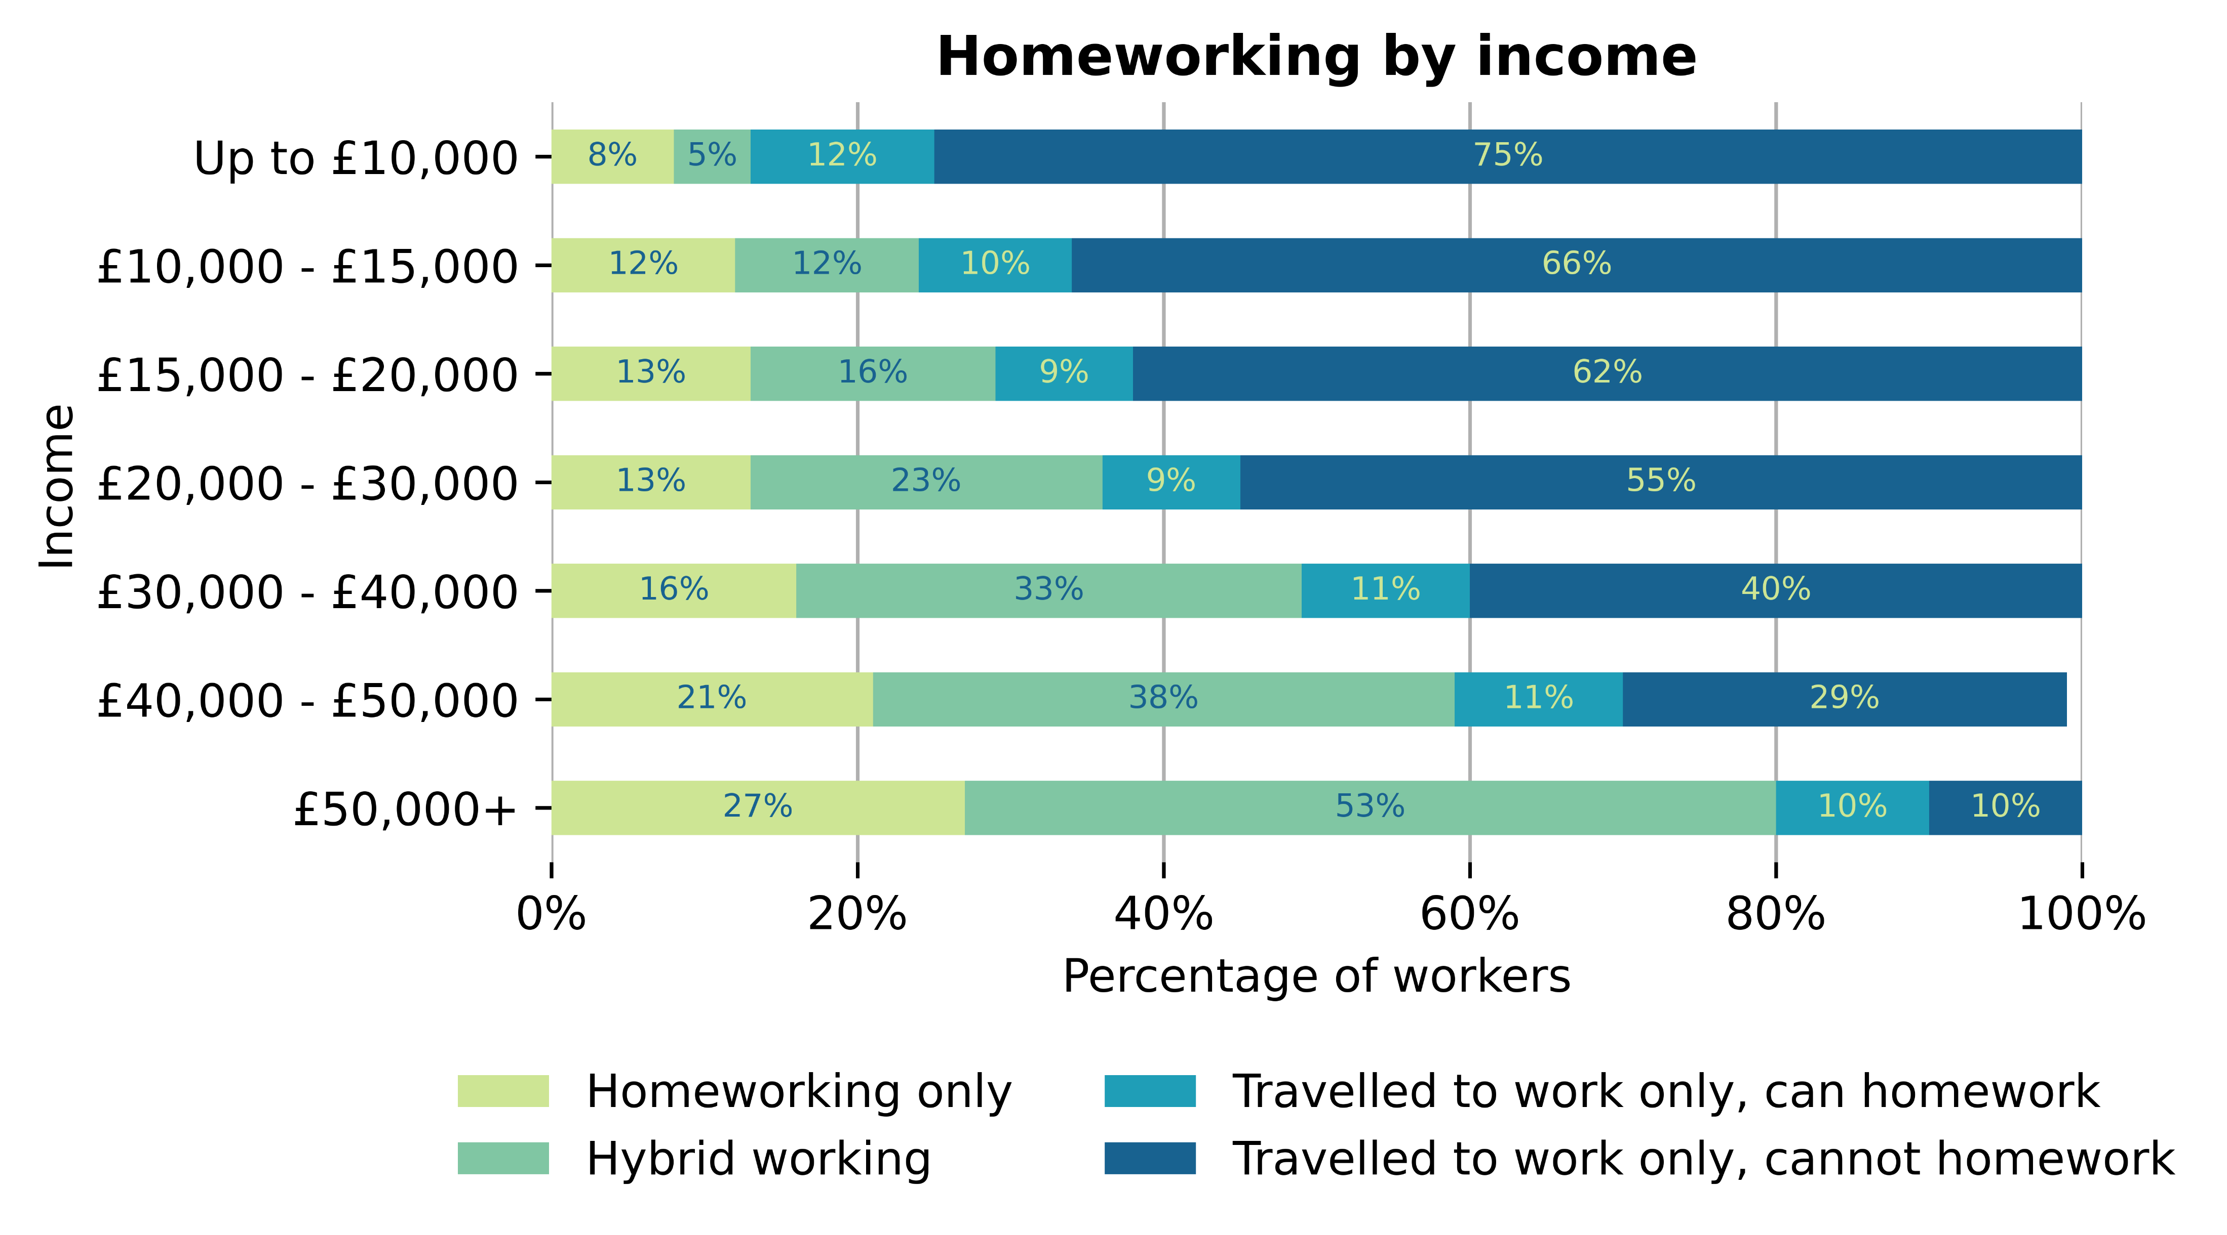
Has the increasing price of energy affect commuters’ transport habits?
Working from home
Finally, when considering possible changes in individuals transport habits, we must also consider how the way that we work has changed dramatically since the Covid-19 pandemic. Namely, the increase in the number of workers working either only from home, or hybrid working. As discussed in the previous slide, those outside of cities are more susceptible to the rising price of energy due to a lack of alternative transport options. However, as seen in the following visualizations, the rate at which workers work from home does vary by location, with the highest rates evidently in the south of England, in the surroundings of London. Furthermore, from the second figure, we see that those on lower incomes are also more likely to be required to travel to work each day. Making them more susceptible to the increased cost of transportation.
Data Science for Policy – September 2023
6
6
Notes:
In particular, we centre our analysis around the 12 levelling up missions, of which, one of the missions is education, which has stated metrics such as the number of primary school children achieving the expected standard in reading, writing and maths. Today, we are interested in if there are spatial disparities in school absences across both England and Wales and how this links to the other levelling up metrics. The governance of education has been devolved in Wales since the creation of the Welsh assembly in 1999 and therefore the collection of school absence data is done independently between England and Wales. The differences in the data collection methods amount to things such as counting half day sessions missed instead of the percentage of pupils absent, how required attendance is counted, etc.

Slide 7
Has the increasing price of energy affect commuters’ transport habits?
Limitations & future work
Availability of data, given additional time I would have aimed to gather more data corresponding to the same time period. This would allow us to gather a more complete picture. For example, the following data:
Price of different travel methods
Availability of public transport
With additional datasets, ideally with a spatial element, I would have liked to explore using machine learning models to cluster the local authorities to try and identify which areas would be affected similarly to the increasing price of energy.
Furthermore, I would also like to explore any potential correlations between the price of energy, transport methods, etc.
Data Science for Policy – September 2023
7
7
Notes:
In particular, we centre our analysis around the 12 levelling up missions, of which, one of the missions is education, which has stated metrics such as the number of primary school children achieving the expected standard in reading, writing and maths. Today, we are interested in if there are spatial disparities in school absences across both England and Wales and how this links to the other levelling up metrics. The governance of education has been devolved in Wales since the creation of the Welsh assembly in 1999 and therefore the collection of school absence data is done independently between England and Wales. The differences in the data collection methods amount to things such as counting half day sessions missed instead of the percentage of pupils absent, how required attendance is counted, etc.

